Slide 1
Chapter-8 Properties of Secure communication
CRYPTOGRAPY

Slide 2
Types of Security
• Computer Security
– generic name for the collection of tools designed to protect data and to thwart hackers
• Network Security
– measures to protect data during their transmission
• Internet Security
– measures to protect data during their transmission over a collection of interconnected networks

Slide 3
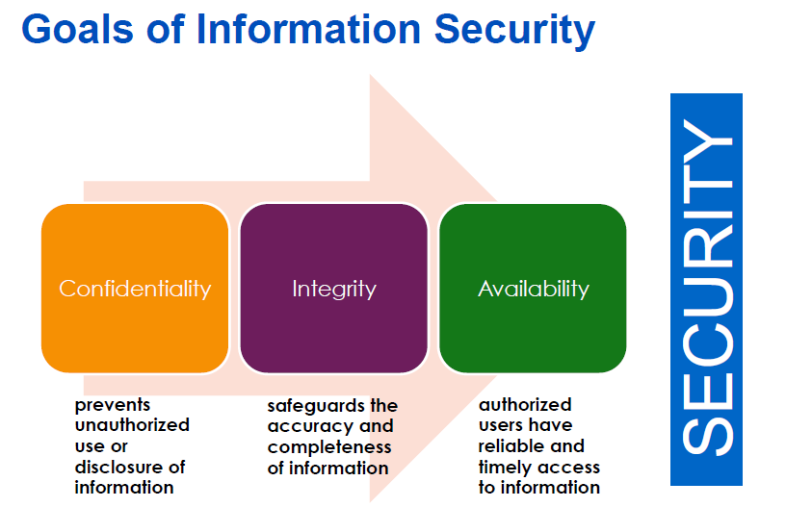

Slide 4
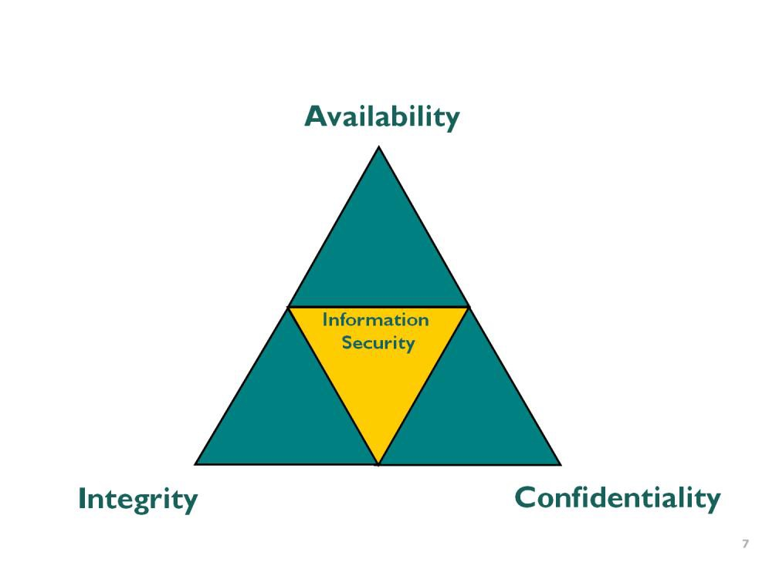
AIC Traid
Confidentiality - Is the concept of protecting the secrecy and privacy of information
Integrity - Is the concept of protecting the “accuracy” of information processing and data from improper modification.
Availability - Is the concept of ensuring that the systems and data can be accessed when required.

Slide 5


Security Needs for Communications
Confidentiality
Authentication
Availability
Interception
Forgery
Denial of Service
Is Private?
Who am I dealing with?
Wish to access!!
Integrity
Non-Repudiation
Access Control
Not
SENT !
Modification
Claim
Unauthorized access
Has been altered?
Who sent/received it?
Have you privilege?

Slide 6
Why Cryptography?
Cryptography is a component of many security systems
It applies to numerous aspects of the security models ( Confidentiality, Authentication, Integrity, Authorization, Non-repudiation)
Desired Property
Threat
Solution
Confidentiality
Disclosure
Encryption for secrecy
Disguising traffic
patterns
Authentication
Spoofing
Digital signature
Integrity
Modification,
Message digests, hashing,
replay
time stamps
Non-repudiation
Denial
Digital signature

Slide 7
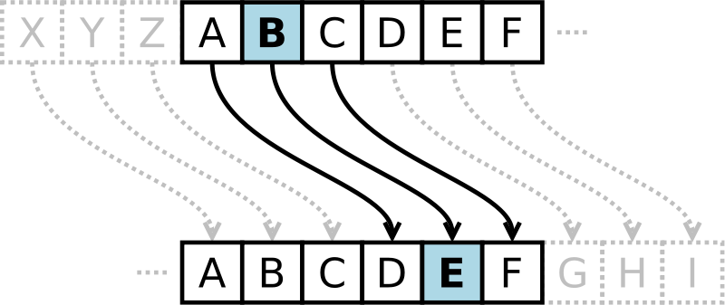
What Is Cryptography
Cryptography is the science of hiding information in plain sight, in order to conceal it from unauthorized parties.
Substitution cipher first used by Caesar for battlefield communications

Slide 8
What is Cryptography?
Cryptography derived its name from a Greek word called “Kryptos” which means “Hidden Secrets”.
Cryptography is the practice and study of hiding information.
It is the Art or Science of converting a plain intelligible data into an unintelligible data and again retransforming that message into its original form.
It provides Confidentiality, Integrity, Accuracy.

Slide 9
Encryption Terms and Operations
Plaintext – an original message
Ciphertext – an encrypted message
Encryption – the process of transforming plaintext into ciphertext (also encipher)
Decryption – the process of transforming ciphertext into plaintext (also decipher)
Encryption key – the text value required to encrypt and decrypt data

Slide 10
Secure Communications
Encryption Key
Decryption Key
Alice
plaintext
Encrypt
ciphertext
Decrypt
Bob
Mallory/ Oscar
Eve
Enemy or Adversary
Fig. Basic Communication Scenario

Slide 11
Eve’s Goals
Read the message
Figure out the key Alice is using and read all the messages encrypted with that key
Modify the content of the message in such a way that Bob will think Alice sent the altered message.
Impersonate Alice and communicate with Bob who thinks he is communicating with Alice.
Oscar is a passive observer who is trying to perform (1) and (2).
Mallory is more active and evil who is trying to perform
(3)And(4).

Slide 12
Attack Methods
Ciphertext only: Alice has only a copy of ciphertext
Known Plaintext: Eve has a copy of ciphertext and the corresponding plaintext and tries the deduce the key.
Chosen Plaintext: Eve has a copy of ciphertext corresponding to a copy of plaintext selected by Alice who believes it is useful to deduce the key.
Chosen Ciphertext: Eve has a copy plaintext corresponding to a copy of ciphertext selected by Alice who believes it is useful to deduce the key.

Slide 13
What is Encryption / Decryption
Encryption –
The process of converting plain text into an unintelligible format (cipher text) is called Encryption.
Decryption –
The process of converting cipher text into a plain text is called Decryption.

Slide 14
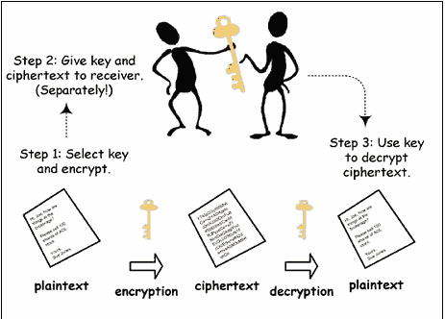
What are the Types of Cryptography
Symmetric Key Cryptography (Secret Key Cryptography)
Same Key is used by both parties
Advantages
Simpler and Faster
Disadvantages
Less Secured
Image taken from :-
www.google.com

Slide 15
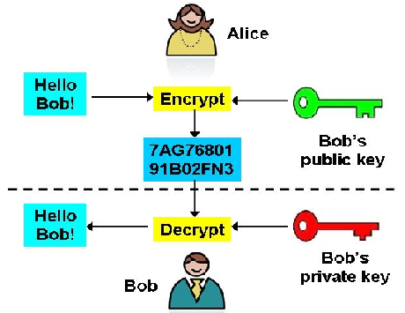
Asymmetric Key Cryptography (Public Key Cryptography)
2 different keys are used
Users get the Key from an Certificate Authority
Advantages
More Secured
Authentication
Disadvantages
Relatively Complex
Image taken from :-
www.google.com

Slide 16

What is a Key
In cryptography, a key is a variable value that is applied using an algorithm to a string or block of unencrypted text to produce encrypted text, or to decrypt encrypted text. The length of the key is a factor in considering how difficult it will be to decrypt the text in a given message.
What is a Block Cipher?
A method of encrypting / decrypting data
Key is used for encryption / decryption.
Same size of I/P and O/P
What is Initialization Vector?
An initialization vector (IV) is an arbitrary number that can be used along with a secret key for data encryption.
It is a group of hex values.

Slide 17
Encryption Methodologies

Slide 18
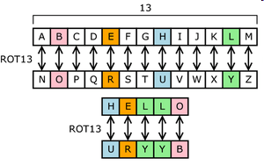
Substitution Cipher
Plaintext characters are substituted to form ciphertext
“A” becomes “R”, “B” becomes “G”, etc.
Character rotation
Caesar rotated three to the right (A > D, B > E, C > F, etc.)
A table or formula is used
ROT13 is a Caesar cipher
Subject to frequency analysis attack

Slide 19
Transposition Cipher
Plaintext messages are transposed into ciphertext
Plaintext: ATTACK AT ONCE VIA NORTH BRIDGE
Write into columns going down
Read from columns to the right
Ciphertext:
AKCNBTAEORTTVRIAOITDCNAHG
Subject to frequency analysis attack
A | K | C | N | B
T | A | E | O | R
T | T | V | R | I
A | O | I | T | D
C | N | A | H | G

Slide 20
Mono-alphabetic Cipher
One alphabetic character is substituted or another
Caesar right-three shift:
Or a more random scheme:
Subject to frequency analysis attack
A | B | C | D | E | F | G | H | I | J | … | Z
D | E | F | G | H | I | J | K | L | M | … | C
A | B | C | D | E | F | G | H | I | J | … | Z
W | E | R | T | B | N | P | Q | C | U | … | X

Slide 21
Running-key Cipher
Plaintext letters converted to numeric (A=0, B=1, etc.)
Plaintext values “added” to key values giving ciphertext
Modulo arithmetic is used to keep results in range 0-26
Add 26 if results < 0; subtract 26 if results > 26
Plaintext | A | T | T | A | C | K | A | T | O | N | C | E | V | I | A | N
Key | S | E | C | R | E | T | S | E | C | R | E | T | S | E | C | R
Plaintext | 0 | 19 | 19 | 0 | 2 | 10 | 0 | 19 | 14 | 13 | 2 | 4 | 21 | 8 | 0 | 13
Key | 18 | 4 | 2 | 17 | 4 | 19 | 18 | 4 | 2 | 17 | 4 | 19 | 18 | 4 | 2 | 17
Sum | 18 | 23 | 21 | 17 | 6 | 3 | 18 | 23 | 16 | 4 | 7 | 23 | 11 | 12 | 2 | 4
Ciphertext | S | X | V | R | G | D | S | X | Q | E | H | X | L | M | C | E

Slide 22
Types of Encryption
Block cipher
Encrypts blocks of data, often 128 bits
Stream cipher
Operates on a continuous stream of data

Slide 23
Block Ciphers
Encrypt and decrypt a block of data at a time
Typically 128 bits
Typical uses for block ciphers
Files, e-mail messages, text communications, web
Well known encryption algorithms
DES, 3DES, AES, CAST, Twofish, Blowfish, Serpent

Slide 24
Stream Ciphers
Used to encrypt a continuous stream of data, such as an audio or video transmission
A stream cipher is a substitution cipher that typically uses an exclusive-or (XOR) operation that can be performed very quickly by a computer.
Plaintext | 1 | 1 | 0 | 1 | 0 | 0 | 1 | 1 | 0 | 1 | 0 | 0 | 1 | 1 | 0 | 0
Key | 0 | 1 | 1 | 0 | 1 | 0 | 0 | 1 | 0 | 1 | 1 | 0 | 1 | 0 | 1 | 0
Ciphertext | 1 | 0 | 1 | 1 | 1 | 0 | 1 | 0 | 0 | 0 | 1 | 0 | 0 | 1 | 1 | 0
Encryption: simple XOR with key
Ciphertext | 1 | 0 | 1 | 1 | 1 | 0 | 1 | 0 | 0 | 0 | 1 | 0 | 0 | 1 | 1 | 0
Key | 0 | 1 | 1 | 0 | 1 | 0 | 0 | 1 | 0 | 1 | 1 | 0 | 1 | 0 | 1 | 0
Plaintext | 1 | 1 | 0 | 1 | 0 | 0 | 1 | 1 | 0 | 1 | 0 | 0 | 1 | 1 | 0 | 0
Decryption: simple XOR with the same key

Slide 25
Stream Ciphers (cont.)
Encryption: simple XOR with key:
Decryption: simple XOR with the same key:
Plaintext | 1 | 1 | 0 | 1 | 0 | 0 | 1 | 1 | 0 | 1 | 0 | 0 | 1 | 1 | 0 | 0
Key | 0 | 1 | 1 | 0 | 1 | 0 | 0 | 1 | 0 | 1 | 1 | 0 | 1 | 0 | 1 | 0
Ciphertext | 1 | 0 | 1 | 1 | 1 | 0 | 1 | 0 | 0 | 0 | 1 | 0 | 0 | 1 | 1 | 0
Ciphertext | 1 | 0 | 1 | 1 | 1 | 0 | 1 | 0 | 0 | 0 | 1 | 0 | 0 | 1 | 1 | 0
Key | 0 | 1 | 1 | 0 | 1 | 0 | 0 | 1 | 0 | 1 | 1 | 0 | 1 | 0 | 1 | 0
Plaintext | 1 | 1 | 0 | 1 | 0 | 0 | 1 | 1 | 0 | 1 | 0 | 0 | 1 | 1 | 0 | 0

Slide 26
Symmetric key
A common secret that all parties must know
Difficult to distribute key securely
Used by DES, 3DES, AES, Twofish, Blowfish, IDEA, RC5
Fig. Symmetric cryptography

Slide 27
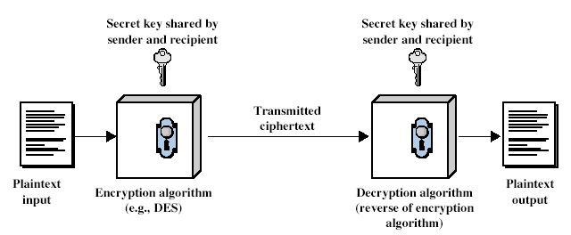
Symmetric Cipher Model
27
Notes:
Detail the five ingredients of the symmetric cipher model, shown in Stallings Figure 2.1:
plaintext - original message
encryption algorithm – performs substitutions/transformations on plaintext
secret key – control exact substitutions/transformations used in encryption algorithm
ciphertext - scrambled message
decryption algorithm – inverse of encryption algorithm

Slide 28
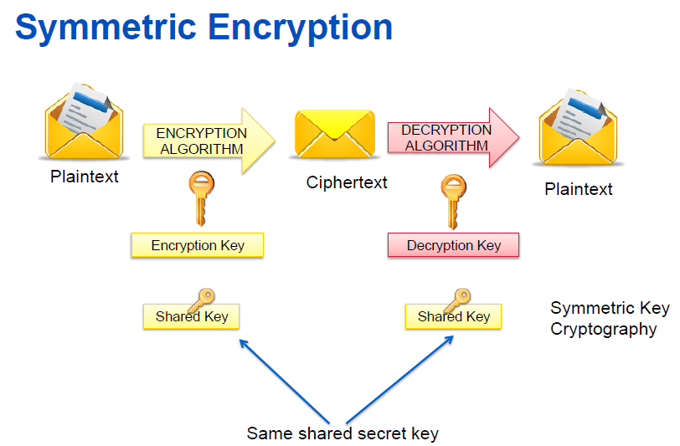

Slide 29
Asymmetric key
Public / private key
Keys mathematically tied together
Openly distribute public key to all parties
Keep private key secret
Anyone can use your public key to send you a message
Used by RSA. El Gamal, Elliptic Curve
Fig. Asymmetric cryptography

Slide 30
Public-Key Cryptography
public-key/two-key/asymmetric cryptography involves the use of two keys:
a public-key, which may be known by anybody, and can be used to encrypt messages, and verify signatures
a private-key, known only to the recipient, used to decrypt messages, and sign (create) signatures
is asymmetric because
those who encrypt messages or verify signatures cannot decrypt messages or create signatures

Slide 31
Asymmetric Encryption Uses
Encrypt message with recipient's public key
Only recipient can read it, using his or her private key
Provides confidentiality
Sign message
Hash message, encrypt hash with your private key
Anyone can verify the signature using your public key
Provides integrity and non-repudiation (sender cannot deny authorship)
Sign and encrypt
Both of the above

Slide 32
Symmetric Cryptography

Slide 33
Data Encryption Standard (DES)
The Data Encryption Standard (DES) is a symmetric-key block cipher published by the National Institute of Standards and Technology (NIST).
In 1973, NIST published a request for proposals for a national symmetric-key cryptosystem. A proposal from IBM, a modification of a project called Lucifer, was accepted as DES. DES was published in the Federal Register in March 1975 as a draft of the Federal Information Processing Standard (FIPS).
There has been considerable controversy over the design, particularly in the choice of a 56-bit key.

Slide 34
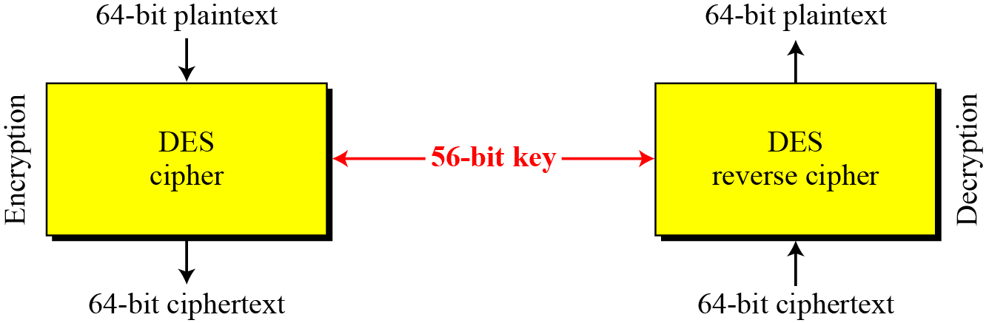
DES Overview
Figure Encryption and decryption with DES

Slide 35
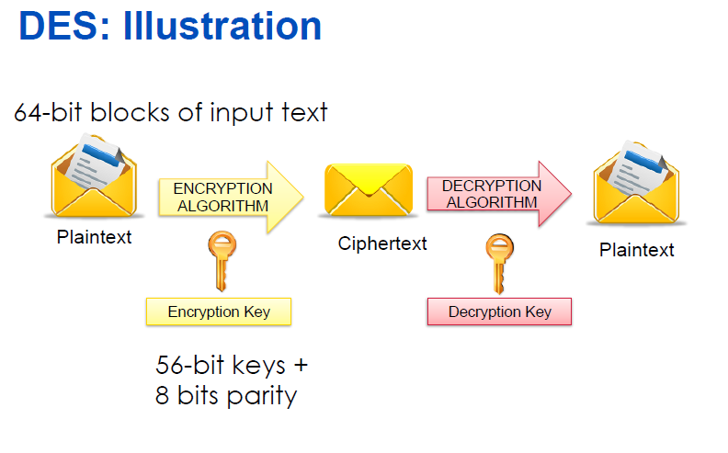

Slide 36
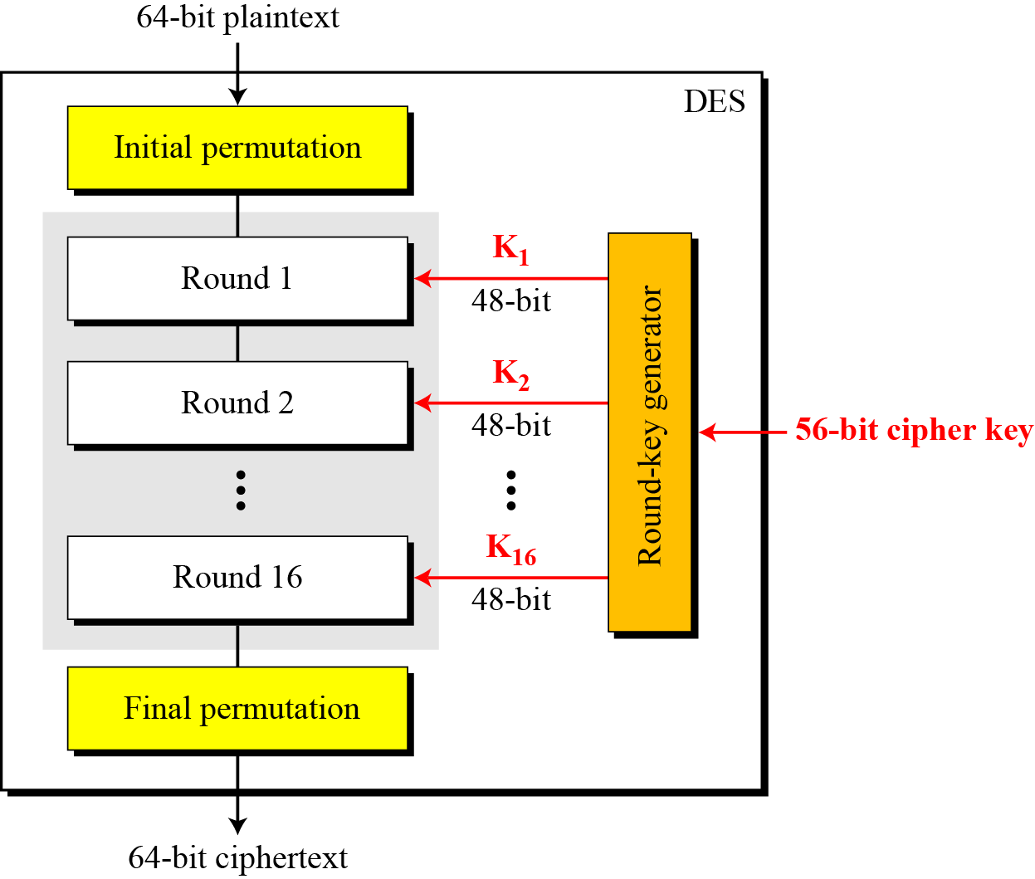
DES Structure
The encryption process is made of two permutations (P-boxes), which we call initial and final permutations, and sixteen rounds of complex key dependent calculation.

Slide 37
DES - Basics
Fundamentally DES performs only two operations on its input, bit shifting (permutation), and bit substitution.
The key controls exactly how this process works.
By doing these operations repeatedly and in a non-linear manner you end up with a result which can not be used to retrieve the original without the key.
By applying relatively simple operations repeatedly a system can achieve a state of near total randomness.

Slide 38
Each Iteration Use of a Different Sub-key
DES works on 64 bits of data at a time. Each 64 bits of data is iterated on from 1 to 16 times (16 is the DES standard).
For each iteration a 48 bit subset of the 56 bit key is fed into the encryption block
Decryption is the inverse of the encryption process.

Slide 39
DES Key Processing
The key is usually stored as a 64-bit number, where every eighth bit is a parity bit.
The parity bits are pitched during the algorithm, and the 56-bit key is used to create 16 different 48-bit subkeys - one for each round.
Subkeys Generation
First, the key is loaded according to the PC-1 and then halved.
Then each half is rotated by 2 bits in every round except the first, second, 9th and last rounds.
The reason for this is that it makes it secure against related-key cryptanalysis.
Then 48 of the 56 bits are chosen according to a compression permutation.

Slide 40
The Key Schedule
The subkeys used by the 16 rounds are formed by the key schedule which consists of:
An initial permutation of the key (PC1) which selects 56-bits in two 28-bit halves
16 stages consisting of
selecting 24-bits from each half and permuting them by PC2 for use in function f,
rotating each half either 1 or 2 places depending on the key rotation schedule KS

Slide 41
3DES or Triple-DES
Triple-DES is a block cipher, which applies the Data Encryption Standard (DES) cipher algorithm three times to each data block.
DES used a single 56-bit key.
3DES uses three 56-bit keys (often just referred to as a 3DES key), and performs three rounds of DES operations on the data.
The result is that DES technology could be used until long term solution (the Advanced Encryption Standard) is found.

Slide 42
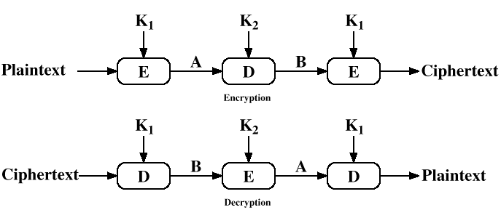
Triple DES - More Secure

Slide 43
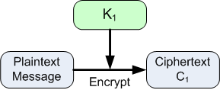
3DES
A typical application of 3DES is known as EDE (Encrypt-Decrypt-Encrypt).
In this case, the first and third keys are equal, so the effective key length is 112-bits.
In the first operation, the plaintext is encrypted with the first DES key, K₁.

Slide 44
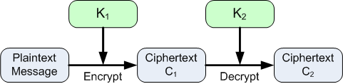
3DES
In the second step, the results of the first step, C₁, is decrypted using the second key, K₂
Since K₂ ≠ K₁, this does not result in the original plaintext message.

Slide 45
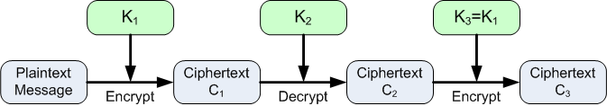
3DES
In the final step, the results of the second step, C₂, is encrypted using the third key, K₃
The output ciphertext C₃ is the final encrypted message.
Recall that K₃ = K₁ in this case, so even though there are three 56-bit keys, the effective key length is only 112-bits.

Slide 46
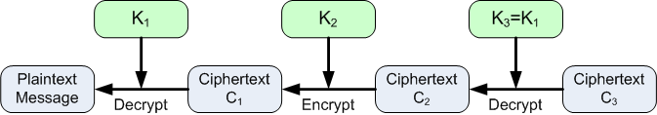
3DES or Triple-DES
Decryption in this case follows the reverse of the encryption process, as shown below.

Slide 47
3DES or Triple-DES
Although the length of the key has doubled, there are 2⁵⁶ (= 72,057,594,037,927,936) times as many keys.
Therefore a brute force search for a 3DES-EDE key would take 2⁵⁶ times longer on the same hardware than a brute force search for a DES key.
There are some approaches that can recover 3DES keys more quickly than brute force searches, but for many kinds of data 3DES is still an acceptable encryption method.

Slide 48
What is DES?
The Data Encryption Standard (DES) is a previously predominant algorithm used for encryption/decryption of electronic data. DES was developed in the early 70’s by IBM which was then submitted to the National Bureau of Standards (NBS).
Like other private key cryptographic methods, both the sender and the receiver must know and use the same private key.
DES uses a 56 bit encryption key which can give around 2^56 (ie) 256 combinations to encrypt the plain text. DES is restricted with a Block Size of just 64bits.
Sometimes DES is said to use 64 bit key, but 8bits out of it is used for some other purpose.
The maximum amount that can be transferred with a single encryption is 32GB. DES uses the Feistel Network which divides block into 2 halves before going through the encryption steps.

Slide 49
What is AES?
The Advanced Encryption Standard (AES) is a specification for the Encryption of electronic data. Originally called “Rijndael” the cipher was developed by 2 Belgian Cryptographers “Joan Daemen” and “Vincent Rijmen” who submitted to the AES Selection process held by the NIST (National Institute of Standards and Technology) in the year 1997 which continued for 3 years and the end result was given on 2nd October 2002 where Rijndael was chosen as the proposed standard.
The algorithm described by AES is a Symmetric-Key Algorithm, meaning the same key is used for encrypting and decrypting the data. AES standard is a variant of Rijndael where the block size is restricted to 128bits and the key size of 128, 192, 256 bits can be used.
AES is based on a design principle known as a substitution-permutation network, and is fast in both software and hardware.

Slide 50
The AES Cipher - Rijndael
designed by Rijmen-Daemen in Belgium
has 128/192/256 bit keys, 128 bit data
an iterative rather than Feistel cipher
processes data as block of 4 columns of 4 bytes
operates on entire data block in every round
designed to have:
resistance against known attacks
speed and code compactness on many CPUs
design simplicity
Notes:
50
The Rijndael proposal for AES defined a cipher in which the block length and the key length can be independently specified to be 128,192,or 256 bits. The AES specification uses the same three key size alternatives but limits the block length to 128 bits. Rijndael is an academic submission, based on the earlier Square cipher, from Belgium academics Dr Joan Daemen and Dr Vincent Rijmen. It is an iterative cipher (operates on entire data block in every round) rather than feistel (operate on halves at a time), and was designed to have characteristics of: Resistance against all known attacks, Speed and code compactness on a wide range of platforms, & Design simplicity.

Slide 51
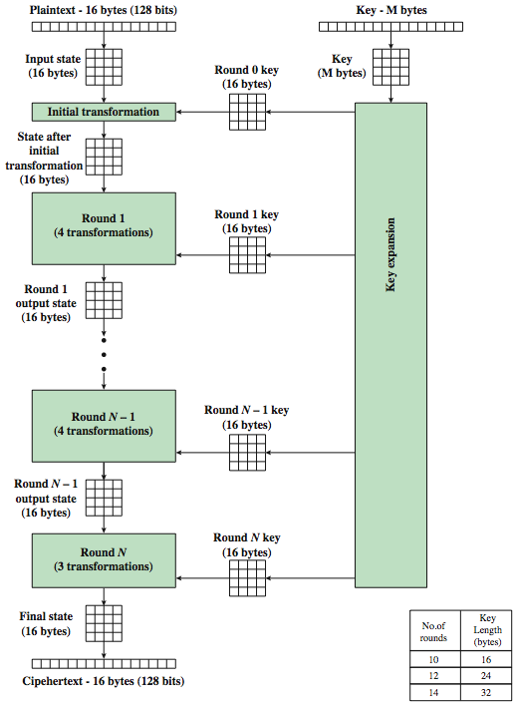
AES Encryption Process
Notes:
51
Stallings Figure 5.1 shows the overall encryption process in AES.

Slide 52
AES Structure
data block of 4 columns of 4 bytes is state
key is expanded to array of words
has 9/11/13 rounds in which state undergoes:
byte substitution (1 S-box used on every byte)
shift rows (permute bytes between groups/columns)
mix columns (subs using matrix multiply of groups)
add round key (XOR state with key material)
view as alternating XOR key & scramble data bytes
initial XOR key material & incomplete last round
with fast XOR & table lookup implementation
Notes:
52
The input to the AES encryption and decryption algorithms is a single 128-bit block, depicted in FIPS PUB 197, as a square matrix of bytes .This block is copied into the State array, which is modified at each stage of encryption or decryption. After the final stage, State is copied to an output.
The key is expanded into 44/52/60 lots of 32-bit words (see later), with 4 used in each round. Note that the ordering of bytes within a matrix is by column. So, for example, the first four bytes of a 128-bit plaintext input to the encryption cipher occupy the first column of the in matrix, the second four bytes occupy the second column, and so on. Similarly, the first four bytes of the expanded key, which form a word, occupy the first column of the w matrix.
The data computation then consists of an “add round key” step, then 9/11/13 rounds with all 4 steps, and a final 10th/12th/14th step of byte subs + mix cols + add round key. This can be viewed as alternating XOR key & scramble data bytes operations. All of the steps are easily reversed, and can be efficiently implemented using XOR’s & table lookups.

Slide 53
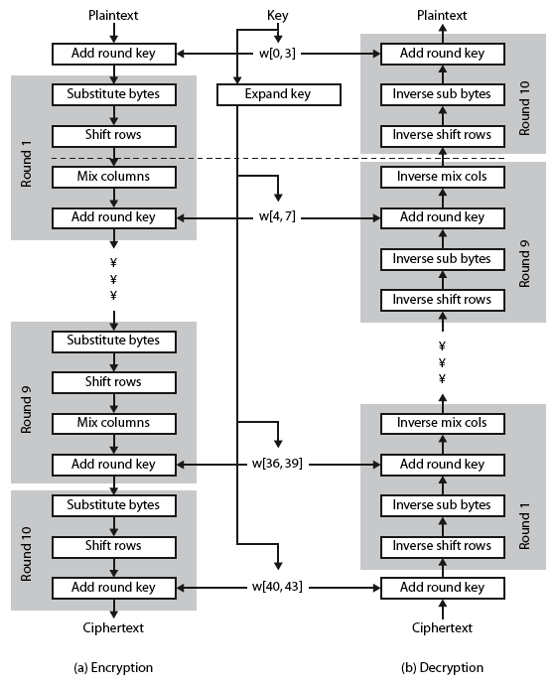
AES Structure
Notes:
53
Stallings Figure 5.3 shows the structure of AES in more detail. The cipher consists of N rounds, where the number of rounds depends on the key length: 10 rounds for a 16-byte key; 12 rounds for a 24-byte key; and 14 rounds for a 32-byte key. The first N – 1 rounds consist of four distinct transformation functions: SubBytes, ShiftRows, MixColumns, and AddRoundKey, which are described subsequently. The final round contains only 3 transformation, and there is a initial single transformation (AddRoundKey) before the first round, which can be considered Round 0. Each transformation takes one or more 4 x 4 matrices as input and produces a 4 x 4 matrix as output. Figure 5.1 shows that the output of each round is a 4 x 4 matrix, with the output of the final round being the ciphertext. Also, the key expansion function generates N + 1 round keys, each of which is a distinct 4 x 4 matrix. Each round key serve as one of the inputs to the AddRoundKey transformation in each round.

Slide 54
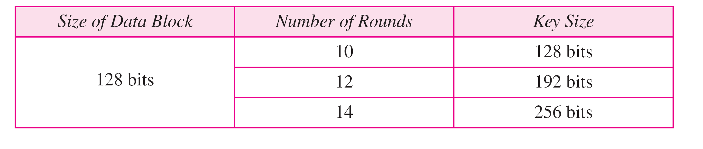
Table: AES configuration

Slide 55
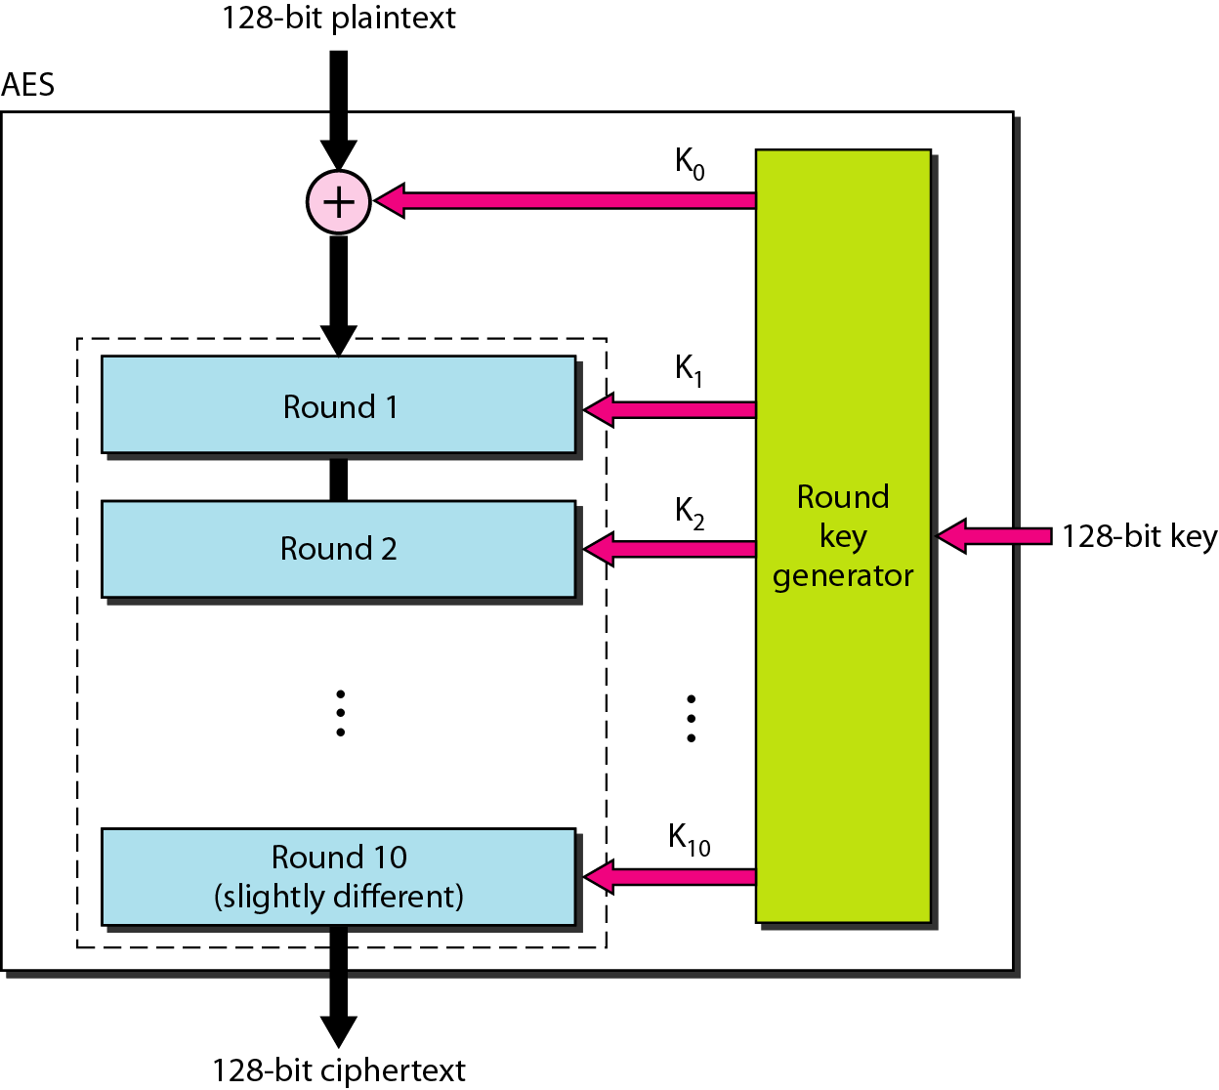
Figure : Advance Encryption Standard

Slide 56
AES
10-round, 128-bit key configuration. The structure and operation of the other configurations are similar.
The difference lies in the key generation.
The general structure is shown in Figure .
There is an initial XOR operation followed by 10 round ciphers. The last round is slightly different from the preceding rounds; it is missing one operation.
Although the 10 iteration blocks are almost identical, each uses a different key derived from the original key.

Slide 57
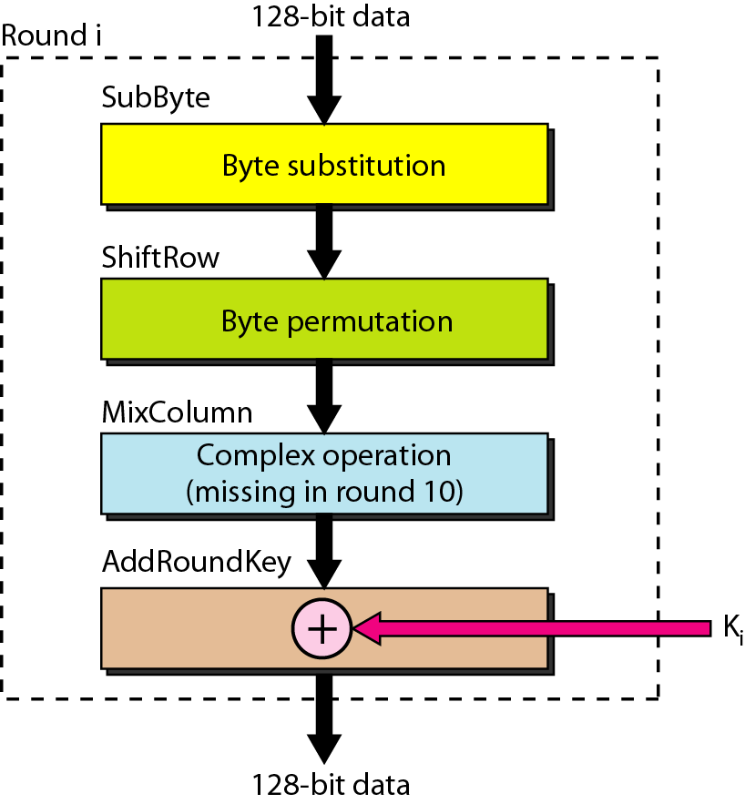
Figure : Structure of each round

Slide 58
Structure of Each Round
Each round of AES, except for the last, is a cipher with four operations that are invertible.
The last round has only three operations. Figure is a flowchart that shows the operations in each round.
Each of the four operations used in each round uses a complex cipher

Slide 59
Some Comments on AES
an iterative rather than Feistel cipher
key expanded into array of 32-bit words
four words form round key in each round
4 different stages are used as shown
has a simple structure
only AddRoundKey uses key
AddRoundKey a form of Vernam cipher
each stage is easily reversible
decryption uses keys in reverse order
decryption does recover plaintext
final round has only 3 stages
Notes:
Before delving into details, can make several comments about the overall AES structure. See text for details.
59

Slide 60
Substitute Bytes
a simple substitution of each byte
uses one table of 16x16 bytes containing a permutation of all 256 8-bit values
each byte of state is replaced by byte indexed by row (left 4-bits) & column (right 4-bits)
eg. byte {95} is replaced by byte in row 9 column 5
which has value {2A}
S-box constructed using defined transformation of values in GF(2⁸)
designed to be resistant to all known attacks
Notes:
60
We now turn to a discussion of each of the four transformations used in AES. For each stage, we mention the forward (encryption) algorithm, the inverse (decryption) algorithm, and the rationale for the design of that stage.
The Substitute bytes stage uses an S-box to perform a byte-by-byte substitution of the block. There is a single 8-bit wide S-box used on every byte. This S-box is a permutation of all 256 8-bit values, constructed using a transformation which treats the values as polynomials in GF(2⁸) – however it is fixed, so really only need to know the table when implementing. Decryption requires the inverse of the table. These tables are given in Stallings Table 5.2.
The table was designed to be resistant to known cryptanalytic attacks. Specifically, the Rijndael developers sought a design that has a low correlation between input bits and output bits, with the property that the output cannot be described as a simple mathematical function of the input, with no fixed points and no “opposite fixed points”.

Slide 61
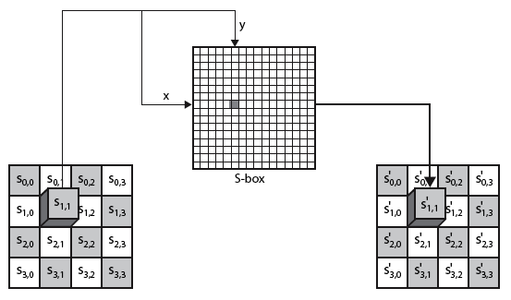
Substitute Bytes
Notes:
61
As this diagram from Stallings Fig 5.5a shows, the Byte Substitution operates on each byte of state independently, with the input byte used to index a row/col in the table to retrieve the substituted value.

Slide 62

Substitute Bytes Example
Notes:
Show an example of the SubBytes transformation from the text.
62

Slide 63
Shift Rows
a circular byte shift in each
1st row is unchanged
2nd row does 1 byte circular shift to left
3rd row does 2 byte circular shift to left
4th row does 3 byte circular shift to left
decrypt inverts using shifts to right
since state is processed by columns, this step permutes bytes between the columns
Notes:
63
The ShiftRows stage provides a simple “permutation” of the data, whereas the other steps involve substitutions. Further, since the state is treated as a block of columns, it is this step which provides for diffusion of values between columns. It performs a circular rotate on each row of 0, 1, 2 & 3 places for respective rows. When decrypting it performs the circular shifts in the opposite direction for each row. This row shift moves an individual byte from one column to another, which is a linear distance of a multiple of 4 bytes, and ensures that the 4 bytes of one column are spread out to four different columns.

Slide 64
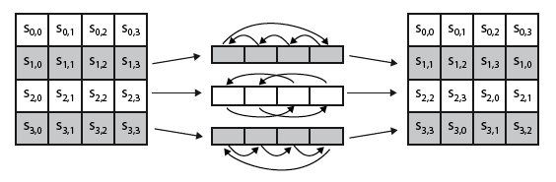

Shift Rows
Notes:
64
Stalling Figure 5.7a illustrates the Shift Rows permutation. Then show an example of ShiftRows from the text.

Slide 65

Mix Columns
each column is processed separately
each byte is replaced by a value dependent on all 4 bytes in the column
effectively a matrix multiplication in GF(2⁸) using prime poly m(x) =x⁸+x⁴+x³+x+1
Notes:
65
The forward mix column transformation, called MixColumns, operates on each column individually. Each byte of a column is mapped into a new value that is a function of all four bytes in that column. It is a substitution that makes use of arithmetic over GF(2^8). Each byte of a column is mapped into a new value that is a function of all four bytes in that column. It is designed as a matrix multiplication where each byte is treated as a polynomial in GF(2⁸). The inverse used for decryption involves a different set of constants.
The constants used are based on a linear code with maximal distance between code words – this gives good mixing of the bytes within each column. Combined with the “shift rows” step provides good avalanche, so that within a few rounds, all output bits depend on all input bits.

Slide 66
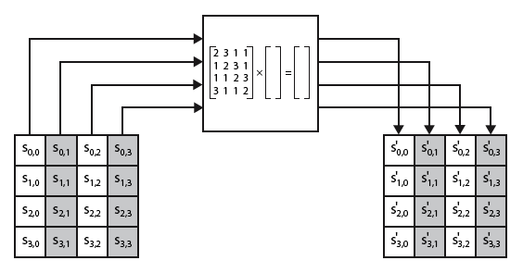
Mix Columns
Notes:
66
Stalling Figure 5.5b illustrates the Mix Columns transformation.

Slide 67

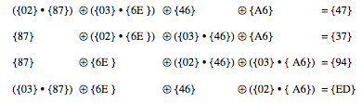
Mix Columns Example
Notes:
Show an example of the MixColumns transformation from the text, along with verification of the first column of this example.
67

Slide 68
AES Arithmetic
uses arithmetic in the finite field GF(2⁸)
with irreducible polynomial
m(x) = x⁸ + x⁴ + x³ + x + 1
which is (100011011) or {11b}
e.g.
{02} • {87} mod {11b} = (1 0000 1110) mod {11b}
= (1 0000 1110) xor (1 0001 1011) = (0001 0101)
Notes:
AES uses arithmetic in the finite field GF(2⁸), with the irreducible polynomial m(x) = x⁸ + x⁴ + x³ + x + 1. AES operates on 8-bit bytes. Addition of two bytes is defined as the bitwise XOR operation. Multiplication of two bytes is defined as multiplication in the finite field GF(2⁸). In particular, multiplication of a value by x (i.e., by {02}) can be implemented as a 1-bit left shift followed by a conditional bitwise XOR with (0001 1011) if the leftmost bit of the original value (prior to the shift) is 1.
68

Slide 69
Mix Columns
can express each col as 4 equations
to derive each new byte in col
decryption requires use of inverse matrix
with larger coefficients, hence a little harder
have an alternate characterisation
each column a 4-term polynomial
with coefficients in GF(2⁸)
and polynomials multiplied modulo (x⁴+1)
coefficients based on linear code with maximal distance between codewords
Notes:
69
In practise, you implement Mix Columns by expressing the transformation on each column as 4 equations (Stallings equation 5.4) to compute the new bytes for that column. This computation only involves shifts, XORs & conditional XORs (for the modulo reduction).
The decryption computation requires the use of the inverse of the matrix, which has larger coefficients, and is thus potentially a little harder & slower to implement.
The designers & the AES standard provide an alternate characterisation of Mix Columns, which treats each column of State to be a four-term polynomial with coefficients in GF(2⁸). Each column is multiplied by a fixed polynomial a(x) given in Stallings eqn 5.7. Whilst this is useful for analysis of the stage, the matrix description is all that’s required for implementation.
The coefficients of the matrix are based on a linear code with maximal distance between code words, which ensures a good mixing among the bytes of each column. The mix column transformation combined with the shift row transformation ensures that after a few rounds, all output bits depend on all input bits. In addition, the choice of coefficients in MixColumns, which are all {01}, {02}, or {03}, was influenced by implementation considerations.

Slide 70
Add Round Key
XOR state with 128-bits of the round key
again processed by column (though effectively a series of byte operations)
inverse for decryption identical
since XOR own inverse, with reversed keys
designed to be as simple as possible
a form of Vernam cipher on expanded key
requires other stages for complexity / security
Notes:
70
Lastly is the Add Round Key stage which is a simple bitwise XOR of the current block with a portion of the expanded key. Note this is the only step which makes use of the key and obscures the result, hence MUST be used at start and end of each round, since otherwise could undo effect of other steps. But the other steps provide confusion/diffusion/non-linearity. That us you can look at the cipher as a series of XOR with key then scramble/permute block repeated. This is efficient and highly secure it is believed.

Slide 71
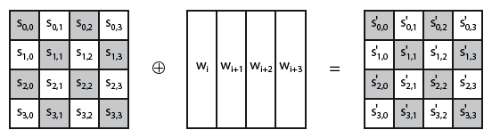
Add Round Key
Notes:
71
Stallings Figure 5.5b illustrates the Add Round Key stage, which like Byte Substitution, operates on each byte of state independently.

Slide 72
DES Encryption | AES Encryption
DES uses only 56 bits key which provides a combination of 2^56 = 256 combinations for encryption. | AES can use 128, 192, 256 bits keys which provides 2^128, 2^192, 2^256 combinations for encryption.
DES is restricted to use a Block Size of only 64 bits | AES is restricted to use a Block Size of 128 bits (double of what is used in DES)
With 64 bits block size, the amount of data that can be transferred with a single encryption key is just 32GB. | With AES, it is possible to transfer around 256 billion GB of data. It is probably safe to say that you can use a single AES encryption key for any application.
DES uses a Feistel network, which divides the block into 2 halves before going through the Encryption steps. | AES uses Permutation-Substitution method, which involves a series of substitution and permutation steps to create the encrypted block.
DES encryption is breakable through Brute Force attack. | AES encryption on the other hand is still not breakable, though there are some theoretical discussions about breaking the AES.
DES is an old technique used for encryption/decryption | AES is relatively new.
Time required to check all the possible keys at 50 billion keys per second – For a 128-bit key: 5x10²¹ years (which makes it difficult for the hackers to decrypt the data) | Time required to check all the possible keys at 50 billion keys per second – For a 56-bit key: 400 days.

Slide 73
Symmetric Key Encryption- Strength
The strengths of modern symmetric key encryption algorithms include:
Fairly fast encryption/decryption process (in comparison to public key techniques, for example)
Several well known, well tested algorithms are available, including 3DES and AES.
Library implementations of symmetric key algorithms are commonly available for many programming languages.

Slide 74
Asymmetric Encryption Uses
Encrypt message with recipient's public key
Only recipient can read it, using his or her private key
Provides confidentiality
Sign message
Hash message, encrypt hash with your private key
Anyone can verify the signature using your public key
Provides integrity and non-repudiation (sender cannot deny authorship)
Originator’s
Originator’s
Private Key
Public Key
Cleartext
Originator’s
Cleartext
Message
Sign
Signed Message
Verify
Message
Originator
Recipient

Slide 75
Algorithms
RSA
De facto public-key algorithm
Variable length keys
Used for key exchange and signatures
Elliptic Curve
Diffie-Hellman key exchange
Used for key exchange only
Digital signature algorithm
Used for signature only

Slide 76
Asymmetric Systems - Requirements
Secrecy of the private key
Must be known only to owner
Key ownership = identity
Availability of the public key
Must be available to anyone
Requires a public directory

Slide 77
Asymmetric Algorithms (continued)
Rivest, Shamir, Adelman algorithm (RSA)
One of the most well-known public key cryptosystems
Developed in the late 1970’s
Relies on the fact that it is extremely difficult to factor large prime numbers

Slide 78
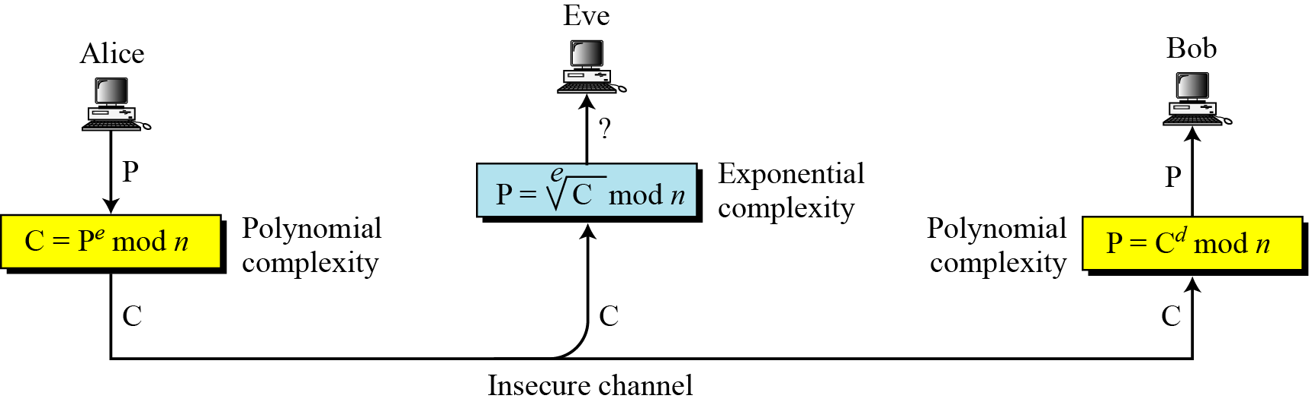
RSA Cryptosystem
The most common public-key algorithm is the RSA cryptosystem, named for its inventors (Rivest, Shamir, and Adleman).

Slide 79
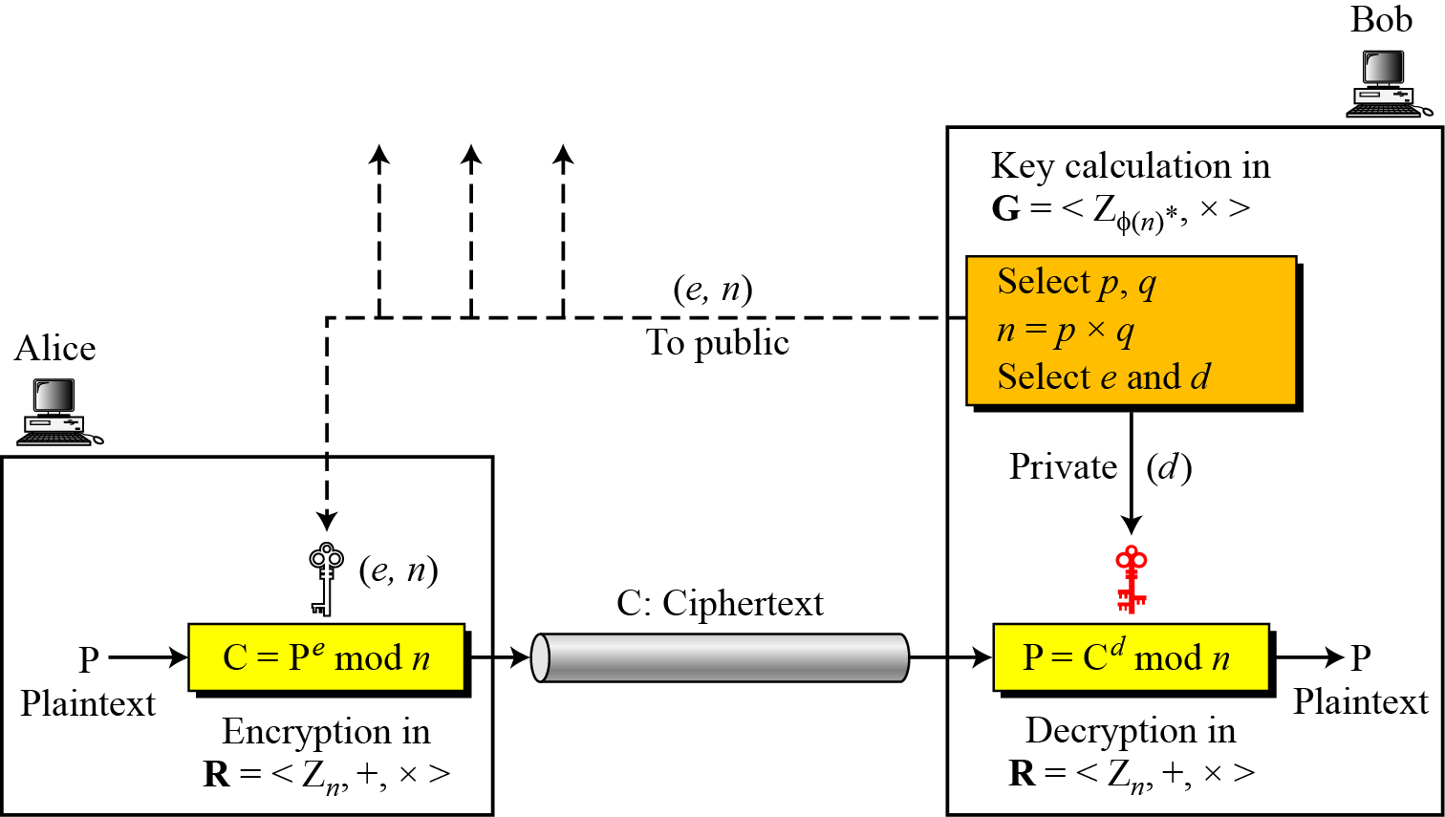
Encryption, decryption, and key generation in RSA

Slide 80
Selecting Keys
The two keys, e and d, have a special relationship to each other,
Selecting Keys
Bob use the following steps to select the private and public keys:
1. Bob chooses two very large prime numbers p and q. Remember that a prime number is one that can be divided evenly only by 1 and itself.
2. Bob multiplies the above two primes to find n, the modulus for encryption anddecryption. In other words, n = p X q.
3. Bob calculates another number ø = (p -1) X (q - 1).
4. Bob chooses a random integer e. He then calculates d so that d x e= 1 mod ø
5. Bob announces e and n to the public; he keeps ø and d secret.

Slide 81
Encryption
Anyone who needs to send a message to Bob can use n and e. For example, if Alice needs to send a message to Bob, she can change the message, usually a short one, to an integer.
This is the plaintext. She then calculates the ciphertext, using e and n.
C=P^e(mod n)
Alice sends C, the ciphertext, to Bob.

Slide 82
Decryption
Bob keeps ø and d private.
When he receives the ciphertext, he uses his private key d to decrypt the message:
P= C^d(mod n)

Slide 83
Restriction
For RSA to work, the value of P must be less than the value of n.
If P is a large number, the plaintext needs to be divided into blocks to make P less than n.

Slide 85
Encryption

Slide 86
Decryption

Slide 87
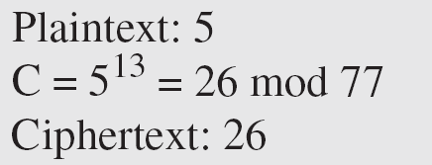
Example
Bob chooses 7 and 11 as p and q and calculates n = 7 · 11 = 77. The value of Φ = (7 − 1) (11 − 1) or 60. Now he chooses two keys, e and d. If he chooses e to be 13, then d is 37. Now imagine Alice sends the plaintext 5 to Bob. She uses the public key 13 to encrypt 5.

Slide 88
Example (continued)
Bob receives the ciphertext 26 and uses the private key 37 to decipher the ciphertext:
The plaintext 5 sent by Alice is received as plaintext 5 by Bob.

Slide 89
Example
Jennifer creates a pair of keys for herself. She chooses p = 397 and q = 401. She calculates n = 159,197 and Φ = 396 · 400 = 158,400. She then chooses e = 343 and d = 12,007. Show how Ted can send a message to Jennifer if he knows e and n.

Slide 90
Example (continued)
Solution
Suppose Ted wants to send the message “NO” to Jennifer. He changes each character to a number (from 00 to 25) with each character coded as two digits. He then concatenates the two coded characters and gets a four-digit number. The plaintext is 1314. Ted then uses e and n to encrypt the message. The ciphertext is 1314³⁴³ = 33,677 mod 159,197. Jennifer receives the message 33,677 and uses the decryption key d to decipher it as 33,677^{12,007} = 1314 mod 159,197. Jennifer then decodes 1314 as the message “NO”. Figure 30.25 shows the process.

Slide 91
Digital Signature: Outline
What is a Digital Signature
Digital Signature Features
Digital Signature Concepts
How Digital Signature Works
How to Register

Slide 92
What is a Digital Signature
Digital signature means a type of electronic signature that transforms a message using an asymmetric cryptosystem ( public and private key capability )
A person having the initial message and the signer’s public key can accurately determine
Whether the transformation was created using the private key that corresponds to the signer’s public key
Whether the initial message has been altered since the transformation was made

Slide 93
A Digital Signature is:
Intended by the party using it to have the same force and effect as the use of a manual signature
Unique to the party using it
Capable of verification
Under the sole control of the party using it
Linked to data in such a manner that it is invalidated if the data is changed
In conformity with rules adopted by Office of Controller of Certification (a Certificate Authority) pursuant to this act

Slide 94
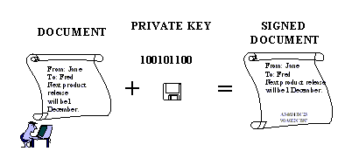
What is a Digital Signature

Slide 95
Digital Signature Features
Signer authentication
Message authentication
Non-repudiation
Integrity

Slide 96
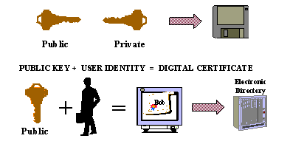
Digital Signature Concepts
The first is that each user has a pair of matching virtual keys ( the private key and public key ), which have a unique mathematical relationship
The second concept is that of a digital certificate

Slide 97
Public-key Cryptography
Each person’s public key is published while the private key is kept secret
Communications involve only the public keys, and no private key is ever transmitted or shared.
The public keys are associated with their users in a trusted manner

Slide 98
Public-key Cryptography
Anyone can send a confidential message by just using public information, but the message can only be decrypted with a private key
Public-key cryptography can be used not only for privacy (encryption), but also for authentication (digital signatures)

Slide 99
Certificate Authority
The Certificate Authority is an individual organization that acts as a notary to authenticate the identity of users of a public-key encryption
A Certificate Authority is used to: 1) Associate a pair of keys with a person 2) Publishing the public keys in a directory 3) Maintain functions associated with the keys

Slide 100
Digital Certificate
The digital certificate acts like an electronic envelope in which the public key travels
This electronic ID file verifies the connection between the public key and the owner
The digital certificate is issued by a Certificate Authority and signed with that Certificate Authority’s private key, authenticating the public key

Slide 101
Digital Certificate
Typically includes:
Public key and owner’s name
Certificate Authority issuing the key
Serial number
Digital signature of Certificate Authority, signed using the Certificate Authority’s private key
Other optional identifying information

Slide 102
Digital Signature Creation
Message
Message
Hash
Function
Message
Digest
Signature
Function
Digital
Signature
Signature Private Key

Slide 103
Digital Signature Creation
Sign
A process known as hash function must occur 1) A hash function is a mathematical algorithm which creates a digital representation or fingerprint in the form of a hash result or message digest
2) The hash function generally consists of a standard length that is usually much smaller than the message but nevertheless substantially unique to it

Slide 104
Digital Signature Creation
Sign
The sender’s digital signature software transforms the hash result into a digital signature using the sender’s private key
Seal
The message is encrypted with a fast symmetric key
Then the symmetric key is encrypted with the receiver’s public key

Slide 105
Digital Signature Verification
If the message
digest are identical,
the signature is valid.
If they are different,
the signature is not
valid.
Message
Hash Function
Message
Digest
Digest
Signature
Signature
Function
Message
Digest
Signer’s Public Key

Slide 106
Digital Signature Verification
Accept
Open
The receiver decrypts the symmetric key by using the receiver’s private key
The message is decrypted using the symmetric key
Verify
Accomplished by computing a new hash result of the original message

Slide 107
Digital Signature Verification
Verify
Then, using the sender’s public key and the new hash result, the verifier checks whether:
1) the digital signature was created using the corresponding private key
2) the newly computed hash result matches the original hash result
The software will confirm the digital signature as: 1) verified 2) failed

Slide 108
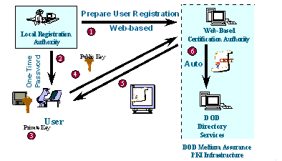
How to register

Slide 109
How to register
A LRA (Local Registration Authority) uploads information about an authorized user
The LRA verifies the user’s identity and provides them with their user number and password
The user connects to the CA, the key pair is generated automatically in the user’s browser, and the private key is stored to their hard drive

Slide 110
How to register
The use’s public key is automatically sent to the CA, and the CA generates the certificate after verifying the user number and password
The CA passes a copy of the certificate back to the user
The CA automatically posts a copy of the certificate in the directory server to make the public key available to others

Slide 111
Summary
Digital signature is based on asymmetric cryptography
Every user has a unique pair of private and public key certified by a trusted Certification Authority
When the sender signs a transaction, a unique mathematical code is created with their private key and the actual content of the transaction
Digital signature can identify the signer’s identity by its relationship to the digital certificate
Digital signature provides more value than any other electronic signature method

Slide 112
Symmetric Versus Asymmetric Cryptosystems
Choice between symmetric and asymmetric cryptosystems involves the number of keys that must be generated
Symmetric cryptosystems don’t scale well
Asymmetric cryptosystems are slower than symmetric ones
Symmetric cryptosystems are excellent for securing the ends of a communication circuit such as a Virtual Private Network
Asymmetric cryptosystems are more practical when there are a large number of users

Slide 113
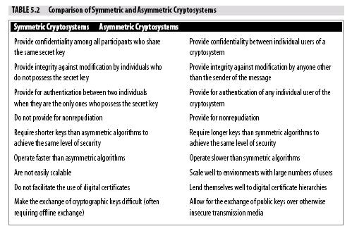

Slide 114
Summary
Goals of cryptography are confidentiality, integrity, nonrepudiation, and authentication
General steps in cryptography are to
Create a plaintext message
Use a cryptographic key and algorithm to produce a ciphertext message
Apply the same or a related key and algorithm to the ciphertext message
Recreate the original plaintext message
There are two types of cryptographic algorithms
Symmetric (uses a shared secret key)
Asymmetric (uses a public and private key pair)

Slide 115
Summary
Digital signatures are used to add integrity and non-repudiation functionality to cryptosystems
Digital signatures are created using hash functions applied to the message to create a message digest that is then encrypted
Digital certificates allow a third party Certificate Authority to verify the identity of a sender who may not be well known to the recipient
A digital certificate is a copy of a user’s public key that has been digitally signed by a Certificate Authority.

Slide 116
Typical Network Architecture
e-mail,
DNS
www
Firewall
Internal
Network
Router
Internet
Internet

Slide 117
What Is a Firewall?
A hardware/software system that securely regulates communication between networks
Typical components of a strong perimeter defense:
Packet filter
Proxy servers
Screening routers
Secure bastion hosts
Authentication server

Slide 118
What Firewalls Can Do
Provide focused security
Centralized administration, configuring, logging, auditing
Focused points of control
Provide a secure network perimeter
Separate sensitive portions of the intranet
Build Virtual Private Networks (VPNs)
Extensions to the network

Slide 119
What Firewalls Can’t Do
Provide complete confidentiality
Eavesdropping is still possible
Firewalls are evolving in this area with VPNs
Provide integrity
No assurances of traffic content
Packets can still be tampered with along the way
Virus checking only beginning to catch on
Prevent packet forgery
No end-to-end controls

Slide 120
Principles of Firewalls
“That which is not explicitly denied, is allowed”
“That which is not explicitly allowed, is denied”
Firewall building blocks:
Packet Filters
Proxy Servers
Screening Routers
Secure Bastion Hosts
Authentication Server

Slide 121
Packet Filter
Router-based or host-based
Access control rules are generally specified by:
Interface
Direction
IP source/destination address
TCP/UDP source/destination port
Protocol
Customized filters

Slide 122
Packet Filter
“telnet mail.COMP.com”
mail.COMP.com
192.193.249.8
shell.COMP.com
163.39.250.195

Slide 123
Packet Filter
Some limitations:
FTP data traffic, UDP, RPC, X Windows
Subject to certain attacks
Stealth Scanning, IP Fragmentation
Configuration and management are difficult
No easy way to upload new rules
No centralized management of security
Routers have limited security capabilities

Slide 124
Other Packet Filtering Limitations
RPC
UDP-based, too many programs to assign given ports
Port numbers dynamically assigned by “portmapper”
RealAudio
Uses TCP ports for initiation
Also uses range of 200 UDP ports (6970-7170)
Dynamic allocation; similar to RPC problem
XWindows
Requires inbound connection
Difficult to filter

Slide 125
Router-Based Packet Filters
Pros:
Inexpensive - you need a router anyway
Cons:
Some well-known limitations (e.g., UDP, RPC)
No authentication
Inadequate logging
Difficult configuration
Order matters
Syntax is complicated

Slide 126
Network Address Translation
Some sites use unregistered IP addresses
Want to hide bogus addresses and use real ones
Solution - Network Address Translation
Described in RFCs 1597 and 1918
There are three ways to translate
Single External Address
One-to-one mapping
Dynamically Allocated Address

Slide 127
Proxy Servers
Internet
Internal Network
External
Router
Bastion Host

Slide 128
Proxy Servers
Modified server software acts as user “proxy”
May require modification of client software
User connects to proxy software but doesn’t access firewall operating system
User interacts with proxy; proxy interacts with server
User and server may not know proxy exists
Session continues transparently after initial connection
Generally application specific

Slide 129
Proxy Servers - Summary
Pros:
Semi-transparent to users
Good logging and auditing of connections
Allows user-based security
Single point of control
No user accounts required in operating system
Strong authentication is possible
Cons:
May require specialized client software
Separate proxy required for each service
Not totally transparent to users

Slide 130
Firewall Trends - Doing More
Firewalls are incorporating more and more technologies (like UTMS)
Web servers, mail servers, and DNS
Virus checking
Authentication
Encryption
Increases usefulness
Increases complexity
Complexity can be the enemy of security

Slide 131
Bastion Host
Machine that is visible to the outside world
Potential target for attacks
Securing bastion host
Monitor closely
Disable all unnecessary services
Remove other programs (compilers, interpreters, etc.)
Turn off “IP forwarding”
Protect existing services with wrappers
Use static routes

Slide 132
Secure Configuration of Routers
Access should be limited
Attach a terminal
Limit access to a few sites (internally)
User/password combination
Not supported by most routers
Authentication
TACACS
Routing
Don’t accept RIP updates
Static route to service provider
Turn off source routing

Slide 133
Firewall Security Systems
Examples of firewall implementations
Screened-host firewall
Dual-homed firewall
Demilitarized zone (DMZ)
Firewall Security Systems
Firewall Platforms
Using hardware or software
appliances versus normal servers
Notes:
Examples of Firewall Implementations
Firewall implementations can take advantage of the functionality available in a variety of firewall designs to provide a robust layered approach in protecting an organization’s information assets. Commonly used implementations available today include:
Screened-host firewall—Utilizing a packet filtering router and a bastion host, this approach implements basic network layer security (packet filtering) and application server security (proxy services). An intruder in this configuration has to penetrate two separate systems before the security of the private network can be compromised. This firewall system is configured with the bastion host connected to the private network with a packet-filtering router between the Internet and the bastion host. Router filtering rules allow inbound traffic to access only the bastion host, which blocks access to internal systems. Since the inside hosts reside on the same network as the bastion host, the security policy of the organization determines whether inside systems are permitted direct access to the Internet, or whether they are required to use the proxy services on the bastion host.
Dual-homed firewall—A firewall system that has two or more network interfaces, each of which is connected to a different network. In a firewall configuration, a dual-homed firewall usually acts to block or filter some or all of the traffic trying to pass between the networks. A dual-homed firewall system is a more restrictive form of a screened-host firewall system, when a dual-homed bastion host is configured with one interface established for information servers and another for private network host computers.
Demilitarized zone (DMZ) or screened-subnet firewall—Utilizing two packet filtering routers and a bastion host, this approach creates the most secure firewall system, since it supports both network and application-level security while defining a separate demilitarized zone network. The DMZ functions as a small isolated network for an organization’s public servers, bastion host information servers and modem pools. Typically, DMZs are configured to limit access from the Internet and the organization’s private network. Incoming traffic access is restricted into the DMZ network by the outside router and protects the organization against certain attacks by limiting the services available for use. Consequently, external systems can access only the bastion host (and its proxying service capabilities to internal systems) and possibly information servers in the DMZ. The inside router provides a second line of defense, managing DMZ access to the private network, while accepting only traffic originating from the bastion host. For outbound traffic, the inside router manages private network access to the DMZ network. It permits internal systems to access only the bastion host and information servers in the DMZ. The filtering rules on the outside router require the use of proxy services by accepting only outbound traffic on the bastion host. The key benefits of this system are that an intruder must penetrate three separate devices, private network addresses are not disclosed to the Internet, and internal systems do not have direct access to the Internet.

Slide 134
Network Infrastructure Security
Firewall Security Systems
Firewall issues
A false sense of security
The circumvention of firewall
Misconfigured firewalls
What constitutes a firewall
Monitoring activities may not occur on a regular basis
Firewall policies
Notes:
Firewall Issues
Problems faced by organizations that have implemented firewalls include:
A false sense of security may exist where management feels that no further security checks and controls are needed on the internal network (i.e., the majority of incidents are caused by insiders, who are not controlled by firewalls).
The circumvention of firewalls through the use of modems may connect users directly to Internet service providers. Management should provide assurance that the use of modems when a firewall exists is strictly controlled or prohibited altogether.
Misconfigured firewalls may allow unknown and dangerous services to pass through freely.
What constitutes a firewall may be misunderstood (e.g., companies claiming to have a firewall merely have a screening router).
Monitoring activities may not occur on a regular basis (i.e., log settings not appropriately applied and reviewed).
Firewall policies may not be maintained regularly.
Most firewalls operate at the network layer; therefore, they do not stop any application-based or input-based attacks.
Examples of such attacks include SQL injection and buffer-overflow attacks. Newer-generation firewalls are able to
inspect traffic at the application layer and stop some of these attacks.

Slide 135
Architectures #1 Bare Bones
Just A Router with Access Control Lists
Very Scaled down
Acceptable, if you are able to control the security on all hosts of internal network
Router
Internal
Network
Internet

Slide 136
Bare Bones Architecture
All your eggs are in the router basket
If the router fails, or if a new attack is devised, you are vulnerable
Not a fine-level of control, logging, management
Not realistic for significantly sized user base

Slide 137
#2 Router and Host Based Firewall
Recommend that filtering be done at both router and firewall
Extra management, but it’s worth it
Internal
Network
Firewall
Router
Internet

Slide 138
Router and Host Firewall Architecture
Concern about where to put servers
WWW, DNS, e-mail
Locate them on firewall
Concerns! If one of the services has a vulnerability, compromise of the entire firewall is possible
Add a DMZ could help alleviate concern

Slide 139
#3 Router and Host Based with DMZ
Add a DeMilitarized Zone (DMZ) for additional services
DMZ aka “perimeter network”
e-mail,
DNS
www
Firewall
Internal
Network
Router
Internet
Internet

Slide 140
Router & Host with DMZ
Keep filtering at both router and firewall
Concern - if one of the servers on the DMZ fails, other servers can be taken over
Attacker grabs the www server and installs a sniffer
Attacker gets passwords for all other machines
To minimize this possibility:
Use a switching hub on the DMZ
Use encryption where possible
Another concern - outside systems only protected by router

Slide 141
#4 Tri-homed Firewall Host
Variation of # 3:
Tri-homed firewall
All logging, suspicious activity detection, etc. of the firewall is available
e-mail,
DNS
www
Internet
Firewall
Internal
Network
Router

Slide 142
Tri-homed Firewall Host
Provides greater protection of DMZ servers
Firewall’s resources can protect and log
Can control at a greater level of detail all accesses to servers on DMZ
Single point to administer protection
Single point of failure

Slide 143
Accessing Internal Hosts from the Internet
Giving access to the public or semi-public to databases inside the corporation
Over the Internet!
Potential for cost-savings is large
On-Line banking, trading, and Insurance applications
For any of the following approaches, use encrypted session (SSL) for transport across Internet

Slide 144
Accessing Internal Hosts from the Internet
Approach A - Replicate
www
DB
Customer
DB
Firewall
Router
Internal
Network
Internet
Somewhat secure, but non-interactive
Providing update access may be required

Slide 145
Accessing Internal Hosts from the Internet
Approach B
Use database Replication
www
DB
Customer
DB
Firewall
Router
Internal
Network
Internet
Be careful punching holes through the firewall
Encrypt if possible
Use switching hub on DMZ

Slide 146
Accessing Internal Hosts from the Internet
Approach C
Very Bad - This bypasses the firewall
Web server provides potential exposure to the internal network
www
DB
Customer
Firewall
Router
Internal
Network
Internet

Slide 147
Accessing Internal Hosts from the Internet
Approach D
WWW server accesses database by going through firewall
Safer than A, with respect to confidentiality because firewall can more tightly control access
Concerns about snooping and hijacking
www
Customer
DB
Firewall
Router
Internal
Network
Internet

Slide 148
Firewall Protocol Policy
Maintain “protocol policy” - identify what is permitted and what is not
Easy to update/maintain lists
Some connections allowed with security in place:
Strong authentication
Access control
Encryption
This should be reflected in policy

Slide 149
Firewall Comparison
PROS
CONS
Application Independent
High Performance
Scalable
Low Security
No Protection Above
Network Layer
Packet
Filters
Application-Proxy Gateways
Good Security
Fully Aware of Application
Layer
Poor Performance
Limited Application Support
Poor Scalability
Good Security
High Performance
Scalable
Fully Aware of Application
Layer
Extensible
More Expensive
Stateful Inspection

Slide 150
Sample Protocol Policy
Service
Policy
Justification
FTP IN
Allowed to DMZ server
Public documents need to be available
Telnet IN
Allowed using strong authentication to specific destinations
Remote users and business partners need to access information, applications
Telnet OUT
Allowed by all full-time employees
Users need to access external information
FTP OUT
Allowed to all users
Users need to access external information
Allowed to DMZ server
Public documents need to be available
HTTP IN
HTTP OUT
Allowed to all users
Users need to access external information

Slide 151
Remote Management of Firewalls
Many firewalls support secured remote management
Or use some form of strong authentication
One-time passwords
Cryptographic authentication
SSH (Secure Shell)
Allows remote login to machine from specific hosts
All traffic encrypted
Knowledge of key is necessary to connect

Slide 152
Remote Access Security Management
Dialup
DSL,ISDN, Wireless computing and Cable modems
Securing Enterprise & Telecommuting Remote Connectivity
Securing external connectivity using SSL, VPN and SSH
Remote Access Authentication systems (TACACS, RADIUS etc.)
Authentication Security protocols (PAP), CHAP etc.
Remote User Management Issues
User support and inventory magement

Slide 153
Methods of Remote Access
Terminal emulation - single window connects to remote system
Such as vt100, other terminal windows
Remote control - direct connection to “captive” remote host
Such as pcAnywhere, Citrix, etc.
Remote node - places remote system on local network
Such as NT/RAS, PPP, NetWare Connect, VPN, PPTP

Slide 154
Remote Access Architectures
Local modems - used for remote control or terminal emulation
Discouraged - difficult to control and monitor
Modem pools - provide centralized dial-in access
Easy to add security/authentication mechanisms
Dial on demand routing
Common with ISDN access
Only connects when traffic is detected
Access servers
Centralized access point - similar to a firewall or router

Slide 155
Remote Access Security
Dialback
Local authentication
Authentication servers
Password authentication
One-time passwords/tokens
Authentication protocols
PPP authentication protocols (PAP, CHAP)
PPTP / L2TP
IPSec
Authentication protocols (TACACS, RADIUS, TACACS+)

Slide 156
Other Access Methods
Cable Modems
Digital Subsciber Loop (DSL)
Both provide high bandwidth to home users
“Always on”
Leads to increased targeting of home systems
Also enables widespread attacks
Personal IDS / Firewall systems
Provide localized protection from remote packets
Use a secure VPN for remote access

Slide 157
IPSec Security Architecture
Detailed in RFCs 2411
Two parts:
Authentication Header (AH)
Encapsulated Security Payload (ESP)
Security Parameters Index (SPI)
Security “associations”
Pre-negotiated keys, algorithms, Initialization Vectors (IVs), etc.

Slide 158
VPN Connectivity Models

Slide 159
VPN Benefits & Needs
VPN is a communication method to leverage the flexibility and cost advantage of the internet.
A VPN allows an enterprise to reduce its dependencies on expensive, leased-line networks and troublesome remote-access solutions, by establishing virtual connections across shared-IP networks.
Internet Service Providers benefit from VPNs by offering multi-tiered VPN services to their customers.

Slide 160
VPN Connectivity Models (Cont)

Slide 161


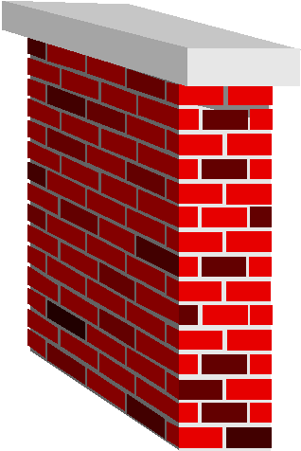

VPN Types
Firewall-to-Firewall
Data is encrypted when it leaves Firewall #1 and crosses the Internet
The data is authenticated and decrypted when it reaches Firewall #2.
Firewall
Module
# 1
Firewall
Module
# 2
Not Encrypted
PRIVATE
Encrypted
PUBLIC
Not Encrypted
PRIVATE
Payroll
Sales

Slide 162
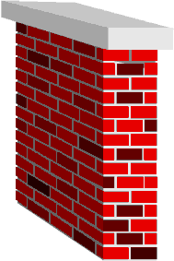

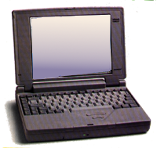


VPN Types
Client-to-Firewall
Firewall or Gateway
With Encryption module
Client with
Encryption package installed

Slide 163
Connectivity Fundamentals
VPN connectivity models rely on creating a Secure Virtual Tunnel between the access points and the enterprise networks.
Tunneling is a protocol that encapsulates various communication protocols in an IP envelop in order to fulfill secure communications requirements.
Most of the current implemented Tunneling protocols are in layer 2 (Data Link), Layer 3 ( Network) and Layer 5 (Session) of the OSI model.

Slide 164


Point-2-Point Tunneling Protocol
PPTP is a tunneling protocol that encapsulates network protocol datagrams within an IP tunnel. This means that any network equipment that treats IP will be able to route this protocol.
Dial-up/Remote Access
RAS/PPTP enabled
ISP
Resource
INTERNET
E N C R Y P T E D
Revolves around Remote Access Services -RAS- for windows (i.e. Network must support
a RAS PPTP enabled server and network equipment that support PPTP).

Slide 165
IP Security Protocol (IPSec)
An IETF sponsored protocol that addresses the lack of security in the existing IP infrastructure.
All devices must share a common key
LAN-2-LAN
INTERNET
E N C R Y P T E D
Works with the existing IP infrastructure via encapsulation.
It secures a packet of data by packaging it inside another packet that is then sent over the Internet.

Slide 166
IPSec Modes
Transport Mode – protects only the payload portion of sent IP packet (I.e. not the header)
Tunnel Mode – protects the entire header and payload of the packet

Slide 167
VPN Assessment
Security Considerations.
Scalability Considerations.
Support & Management Considerations.
Cost Considerations.

